Slide 1

The midterm evaluation
Adjustable Phone Stand
Basic idea is to hold a phone in a desired angle and position for prolonged periods of time
For example in a remote exam situation
Phone locked in place for several hours
Needs to be reliable and robust
Group: Axel Wester, Santeri Heikkinen, Tuomas Peltoketo, Helena Helisten

Slide 2
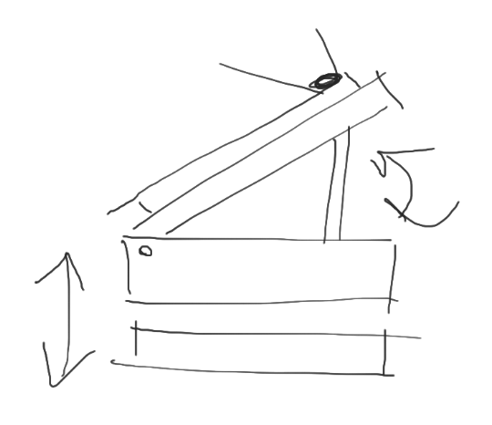
Design process
In the initial design the height alongside with angle could be adjusted
Function to change height was scrapped later on
Height and angle of the phone changed with push-buttons
Angle to be changed with a potentiometer
Positions of the phone were to be memorized utilizing a sensor
Scrapped later on
Light sensor to tell if the position of the phone is adequate
Picture 1: The initial sketch of the device

Slide 3
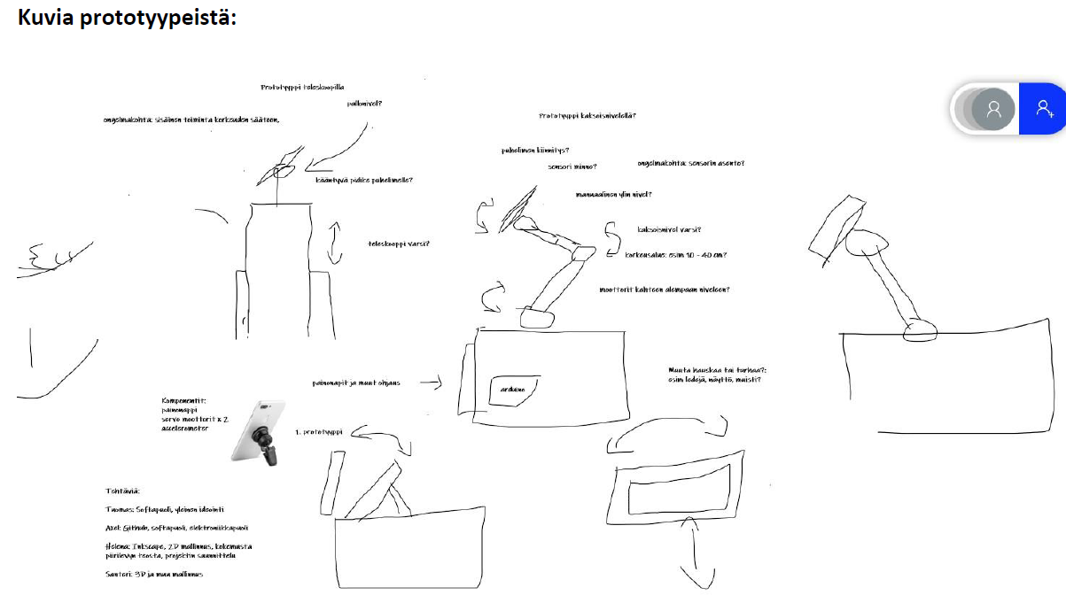
Solidifying the design
Different design concepts were considered
Telescope design
Arm design
Two joint design
Three joint design
Ball-and-socket joint to change the angle
Design got overly complicated and needed to be simplified!
Looped back to initial design
Picture 2: Different possible concepts for the design.

Slide 4
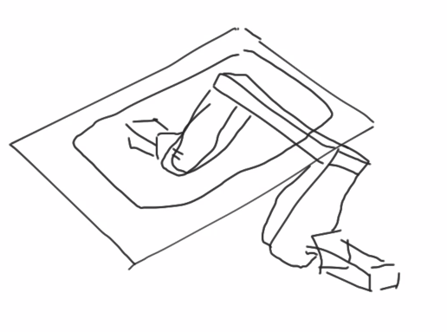
The list of components
Arduino Uno/Nano
3x Resistors 230Ω
3x LED
2x Servomotor RC 4.8V
Potentiometer 10 kΩ 1/32 W
Breadboard
Jumper cables
Battery mount
4x AAA batteries
TEMT6000 Ambient Light Sensor
Picture 3: A possible concept to change the angle. (Sketch by Georgi in TA-session)
Servomotors were decided most suitable for the design
Two on each side to ensure stability
Strong enough to hold up different sized phones

Slide 5
Links
GitHub:
https://github.com/admwester/adjustable-phone-stand
Introductory report:
https://www.digifab-oulu.com/2021/03/25/introductory-report-of-adjustable-phone-stand/
Learning Diary:
https://www.digifab-oulu.com/2021/04/01/learning-diary-report-of-adjustable-phone-stand-w11-13/

